Slide 1




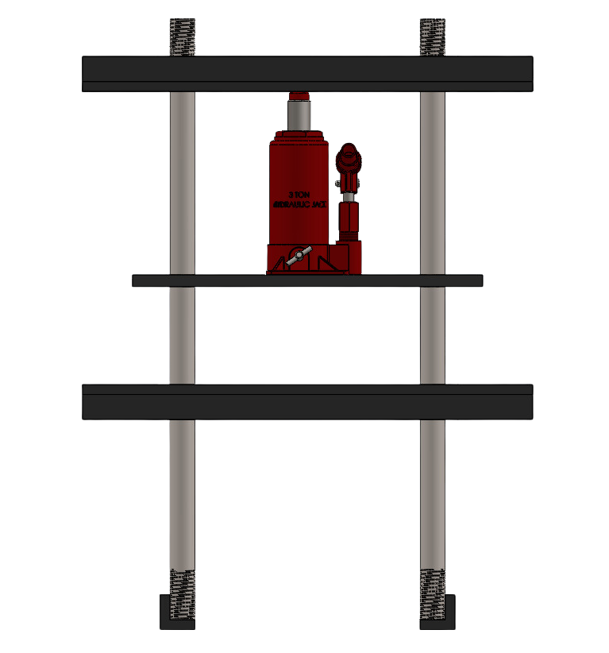




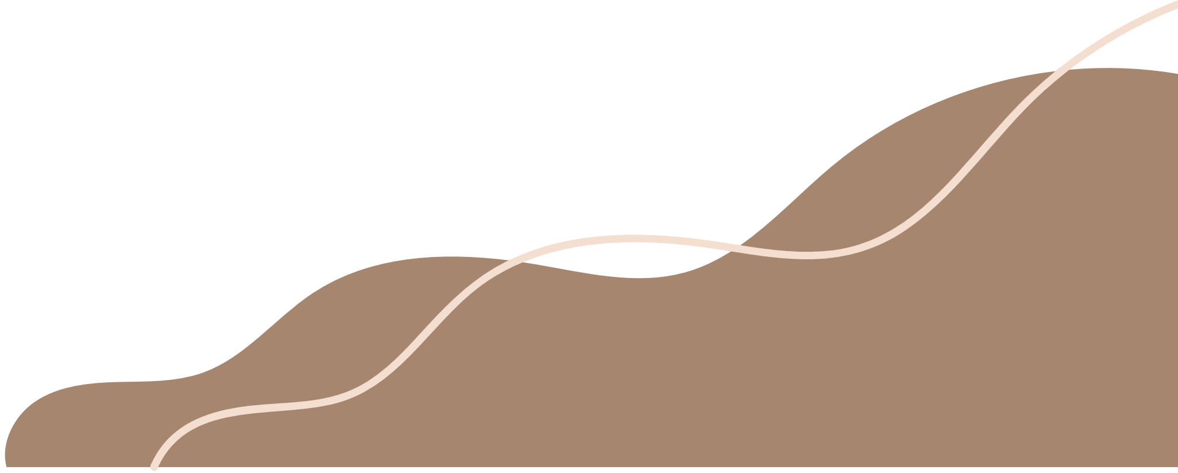
LAb
Project
Submitted to: Syed Saqib

Slide 2




Our Team
Rizwan
Ali
M. Ikram
Zain
Shabir
Ali
Hassan
M. Younas
tilsan
Kabir
Usama
Mushtaq
Asghar
Watto
Arsalan
Asif

Slide 3

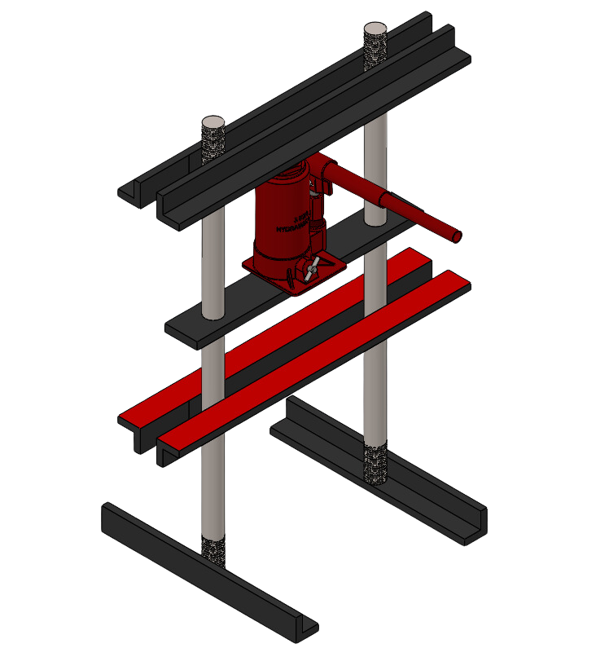


Introduction
This presentation outlines our fluid mechanics lab project, focusing on the design and application of a hydraulic press. Hydraulic systems play a crucial role in various engineering fields, and understanding their principles is essential for practical applications.

Slide 4

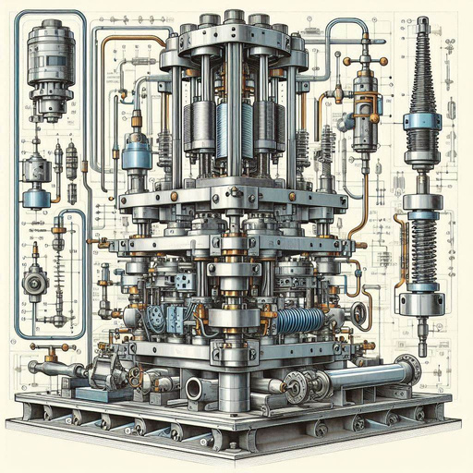

Background
  Pascal's Law, formulated in the 17th century, laid the foundation for modern hydraulic principles.
  Hydraulic presses emerged as versatile tools for shaping and compressing materials.
  Advancements in materials and manufacturing techniques fueled the widespread adoption of hydraulic technology.
  Hydraulic systems continue to play a vital role in various industries due to their force generation and precision control capabilities.

Slide 5

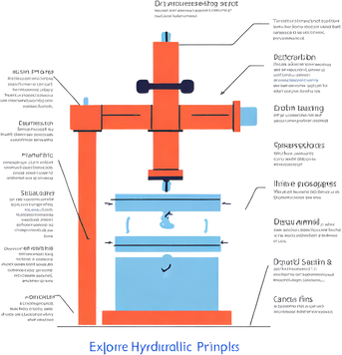
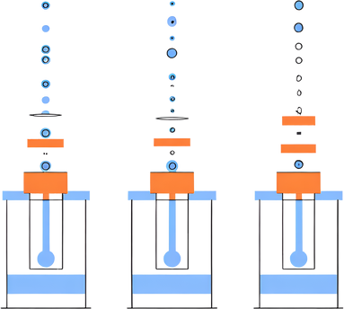
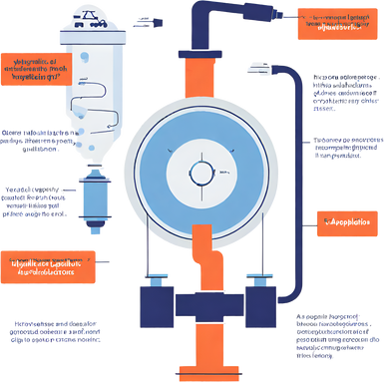


Objectives
Explore Hydraulic System Principles with a Hydraulic Press
Explore Force, Pressure, and Fluid Mechanics Through Hydraulic Press Experiments
(at least 2)
Gain Practical Insights into Hydraulic Technology Applications

Slide 6


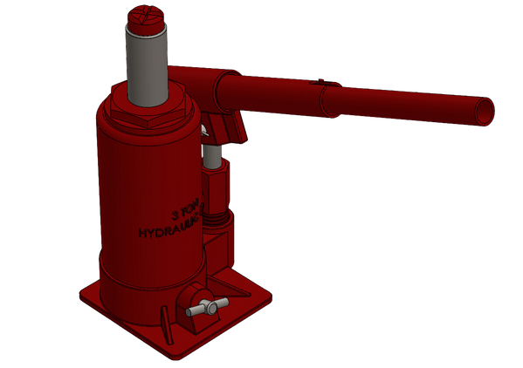
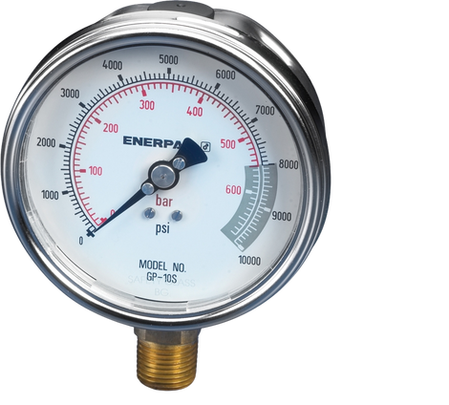
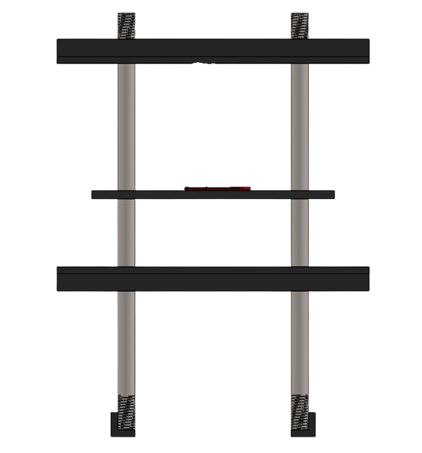

COMPONENETS
Hydraulic jack
Load capacity: 3 ton
Bourdon pressure gauge
Load value up to :250 Kg/Cm2
Iron stand with
move able metal strip
Solid welded stage

Slide 7
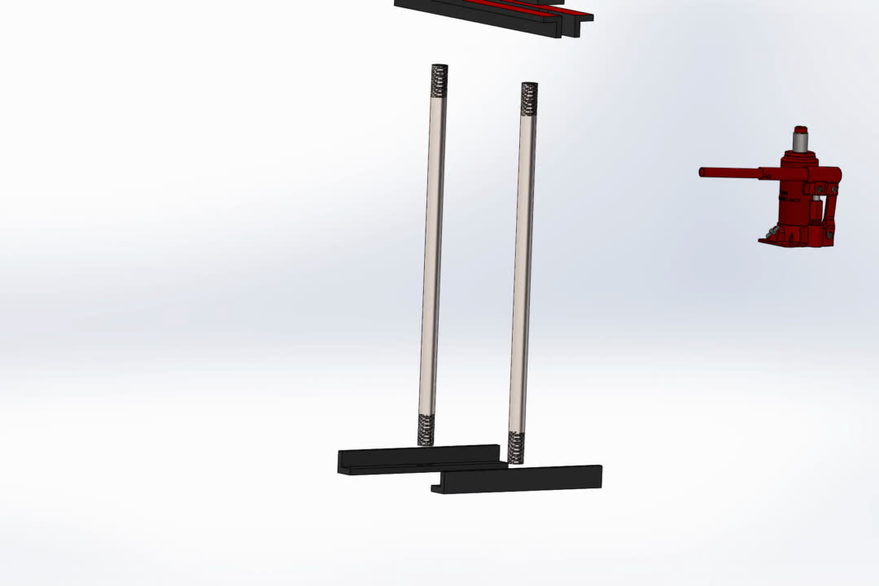
CONFIGURATION

Slide 8
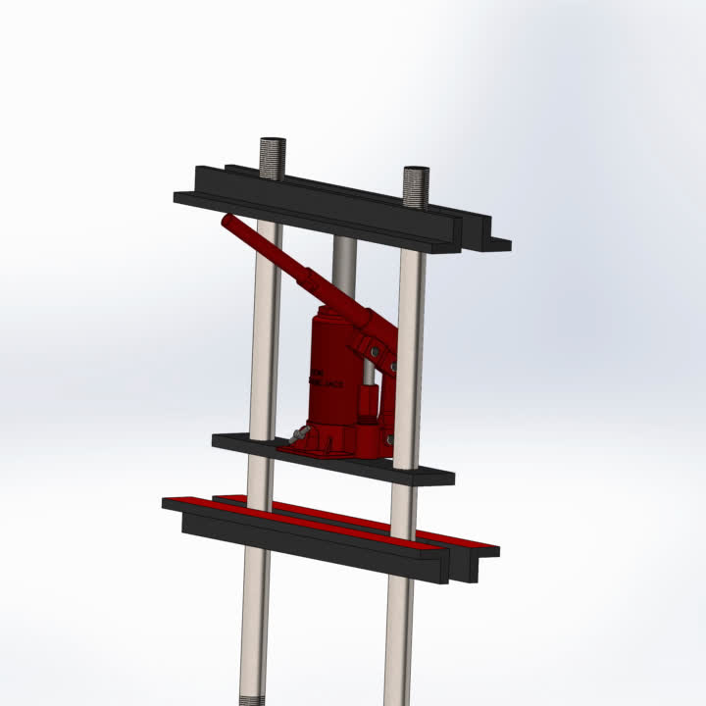
Working
  Place the load to be tested on the lower jaw (red-colored surface) of the hydraulic press.
  Initiate loading by pushing the lever to activate the hydraulic jack.
  Monitor the pressure gauge readings as the hydraulic jack applies force to the load.
  Record the final pressure reading from the pressure gauge for calculation and analysis.

Slide 9


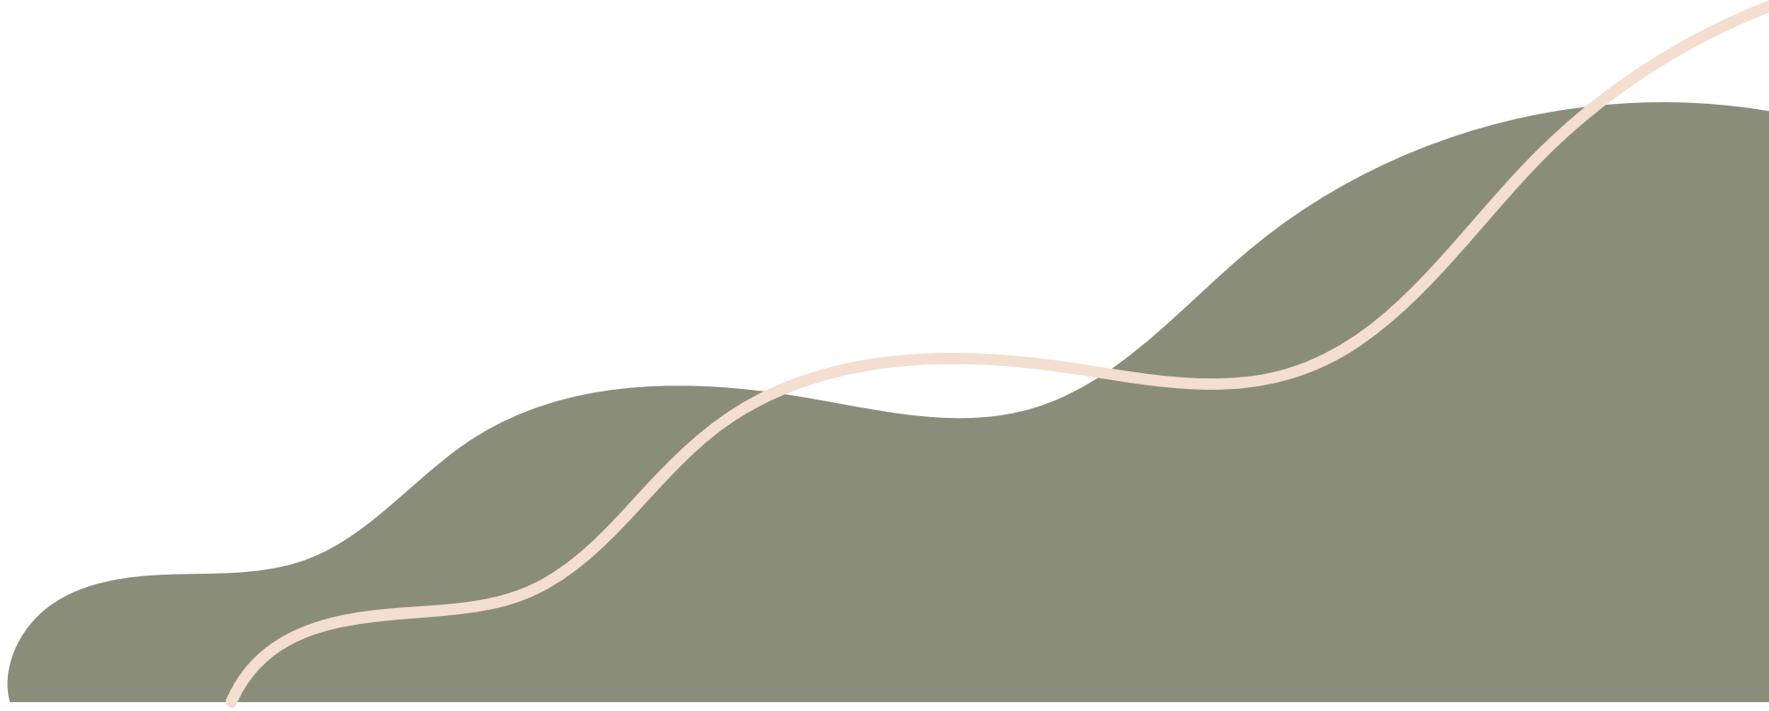

Experiment#1
Pressure Measurement
  Objective: Measure the pressure exerted by the hydraulic jack using the embedded pressure gauge.
  Procedure:
    Ensure the hydraulic press is properly set up and secured.
    Place a load or object to be tested on the lower jaw of the hydraulic press.
    Activate the hydraulic jack by pushing the lever.
    Monitor the pressure gauge readings as the hydraulic jack applies force to the load.
    Record the final pressure reading once the desired force is reached.
  Expected Results: The pressure gauge will indicate the pressure corresponding to the applied force, demonstrating the relationship between force and pressure in a hydraulic system

Slide 10
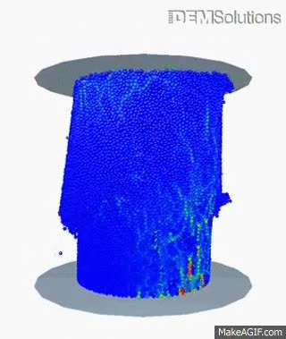
Experiment#2
Force Application
  Objective: Demonstrate the application of force using the hydraulic press.
  Procedure:
    Prepare various objects of different materials and sizes to be tested.
    Place one object at a time on the lower jaw of the hydraulic press.
    Activate the hydraulic jack by pushing the lever, applying force to the object.
    Observe and record the effects of force on the object, such as compression or deformation.
    Repeat the process with different objects to compare the results.
  Expected Results: The hydraulic press will exert force on the objects, causing compression or deformation depending on their properties.

Slide 11

ADVANTAGES OF HYDRUALIC SYSTEMS
  High force generation: Hydraulic systems can generate significant force with relatively small input forces, making them suitable for heavy-duty applications.
  Smooth operation: The fluid-based nature of hydraulic systems allows for smooth and precise control of force and motion.
  Precise control: Hydraulic systems offer precise control over force, speed, and position, enabling accurate and consistent performance.
  Versatility: Hydraulic systems can be adapted for various applications, including lifting, pressing, bending, and shaping operations.
  Safety: Hydraulic systems can incorporate safety features such as pressure relief valves and overload protection, enhancing operational safety.

Slide 12
DISADVANTAGES OF HYDRUALIC SYSTEMS
  Potential leaks: Hydraulic systems may experience leaks due to wear and tear or seal failures, leading to fluid loss and decreased efficiency.
  Maintenance requirements: Hydraulic systems require regular maintenance, including fluid checks, filter replacements, and seal inspections, to ensure optimal performance and prevent breakdowns.
  Cost: Hydraulic systems can be expensive to install and maintain, including the cost of hydraulic fluid, replacement parts, and labor.
  Complexity: Hydraulic systems involve complex components and mechanisms, requiring specialized knowledge for design, installation, and troubleshooting.
  Environmental impact: Hydraulic fluid leakage can pose environmental hazards if not properly managed, leading to soil or water contamination.

Slide 13
CONCLUSION
In summary, our study of hydraulic systems through the construction and analysis of the hydraulic press has provided valuable insights into their operation and applications. Through hands-on experimentation, we've observed the relationship between force, pressure, and fluid mechanics. This project enhances our understanding of hydraulic technology and its significance in engineering.

Slide 14
Thank You

